Slide 1
WICCI COUNCIL NAME (CONSTRUCTION COUNCIL)
WOMEN´S INDIAN CHAMBER OF COMMERCE AND INDUSTRY
www.wicci.in

Slide 2
Council Vision &Mission
Health & safety concern of woman in construction
Lack of toilet facility
Lack of potable drinking water
Long working hour
Working conditions
Sustainable construction technology
Sustainable planning
Use local construction material to improve the local economy
Sustainability is an integration between economic, environmental and social aspects.
Child education in construction site worker
Safety hazards
child education in construction site.
New Construction Technology
To Education about the New construction Technology and construction material
Reuse and Recycle the material
Garbage control for environment point of view
Coordinating about the various authority regarding construction , compliances , byelaws , environment and sustainability point of view
To promote awareness of Insurance policy to the companies about the construction site for Labor

Slide 3
Welcoming
Council Members to
WICCI
President, Vice President
and 20+ Nominated Council Members

Slide 4
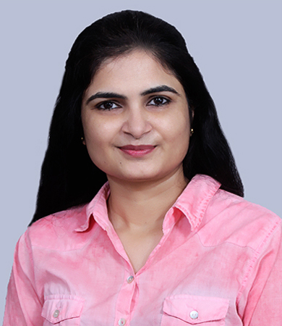
SONIA AHUJA , STATE PRESIDENT
CONSTRUCTION COUNCIL WICCI
Versatile seasoned professional having +15 year experience in managing diverse projects from Warehouse, Group Housing, Residential Tower, Hospital, Institutional, It Parks, Hospitality, University and mixed use commercial building.
High end Interior, Retail Interiors and Cooperate Interiors and landscape.
robust educational background, holding a B. Arch, Valuation and an M. Arch with a Landscape specialization.
She is a member of various industry associations, including
IBBI approved Valuer (land and Building)
CEV RVO
CEVIAF
Fellow Member of IIA
EC Member of IIA Haryana Chapter (20-23)
Jt. Hon. Secretary of Haryana Chapter (2023-2025).

Slide 5
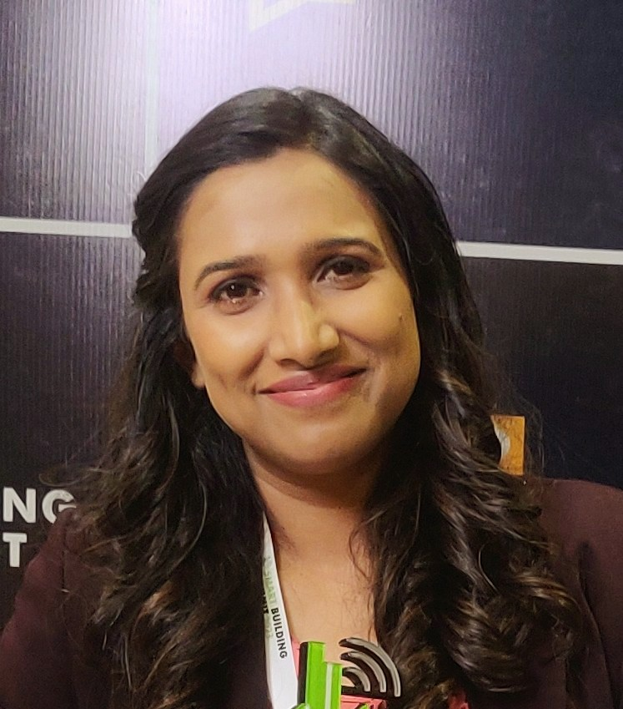
GLORY SRIVASTAVA, VICE PRESIDENT
CONSTRUCTION COUNCIL WICCI
Glory is a passionate Architect with 20 years of experience in managing diverse projects ranging from group housing to high-rise luxury residential towers, IT parks, hospitality, and mixed-use commercial buildings.
She is an ECBC expert, LEED GA, IGBC AP, and GRIHA CP & Evaluator, GEM CP.
She specializes in incorporating sustainable features and BIM technologies in her designs.
Glory has a post-graduate degree in Environmental Management Studies and a Master's in Architecture from India.
She is a member of various industry associations, including
IIA Haryana
ASHRAE Chandigarh Chapter, and the
Past president of ISHRAE Lucknow chapter, and
Program chair for the ASSOCHAM GEM UP chapter.

Slide 6
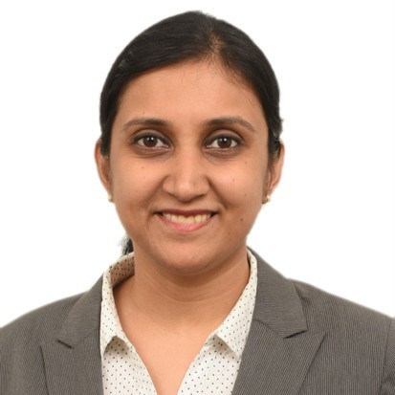
MEENAKSHI, COUNCIL MEMBER
CONSTRUCTION COUNCIL WICCI
Landscape architect and research professional with fourteen plus years of experience in landscape design and planning. Worked on a variety of large scale urban projects pan India. My doctoral research focuses on resource efficient green infrastructure planning in India. Through my journey in research, I have had the opportunity to co- author a book chapter and present my work at international research forums and conferences.
My Interests include: green infrastructure planning; nature based solutions; resource efficient development, climate change adaptation

Slide 7
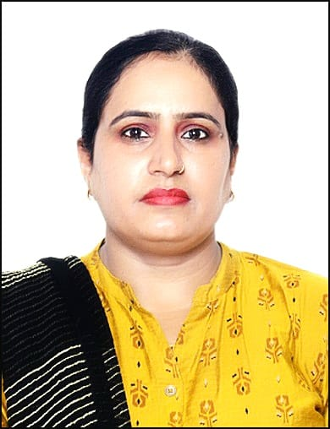
AR. SUNITA KUMAR, COUNCIL MEMBER
CONSTRUCTION COUNCIL WICCI
Sunita Kumari is a dedicated & accomplished Architect with 13 years of experience in managing diverse projects ranging from Institution, Hospital, Affordable Group Housing , Commercial Buildings,Industrial,Hotels, Residential & Marriage Palace.
She has a post graduate degree in Master Planning in Housing at SPA Delhi.
She done work on Planning and designing Plotted Colonies & Deen Dayal Awas Yojna (DDJAY) Scheme.
Sunita Kumari has a graduate degree in LL.B (Bachelor of Legislative Law).
She is a member of various industry associations, including
Council of Architecture (COA) Delhi
Indian Institute of Architect (IIA ) Haryana
Institute of Town Planner India (ITPI) Delhi
District Bar Association Gurugram Haryana
E.C (Executive Committee) Member of IIA Gurgaon Center .
The Indian Institution of Valuer (India)

Slide 8
AR. RAJNI LAKHNI, COUNCIL MEMBER
CONSTRUCTION COUNCIL WICCI
Meet Architect Rajni has a post graduate degree in Construction Management. Masters in Urban and Rural Planning.
seasoned professional & accomplished Architect with 23 years of experience in managing diverse projects ranging from Institution, Hospital, Affordable Group Housing , Commercial Buildings, Industrial, Hotels, Residential & Marriage Palace.
She done work on Planning and designing Plotted Colonies , Group Housing , Site Management , Commercial Project & Deen Dayal Awas Yojna (DDJAY) Scheme.
Her thirst for innovation sets her apart, ensuring that her work remains fresh, on-trend, and at the forefront of the industry.
She is a member of various industry associations, including
Council of Architecture (COA) Delhi
Indian Institute of Architect (IIA ) Haryana

Slide 9
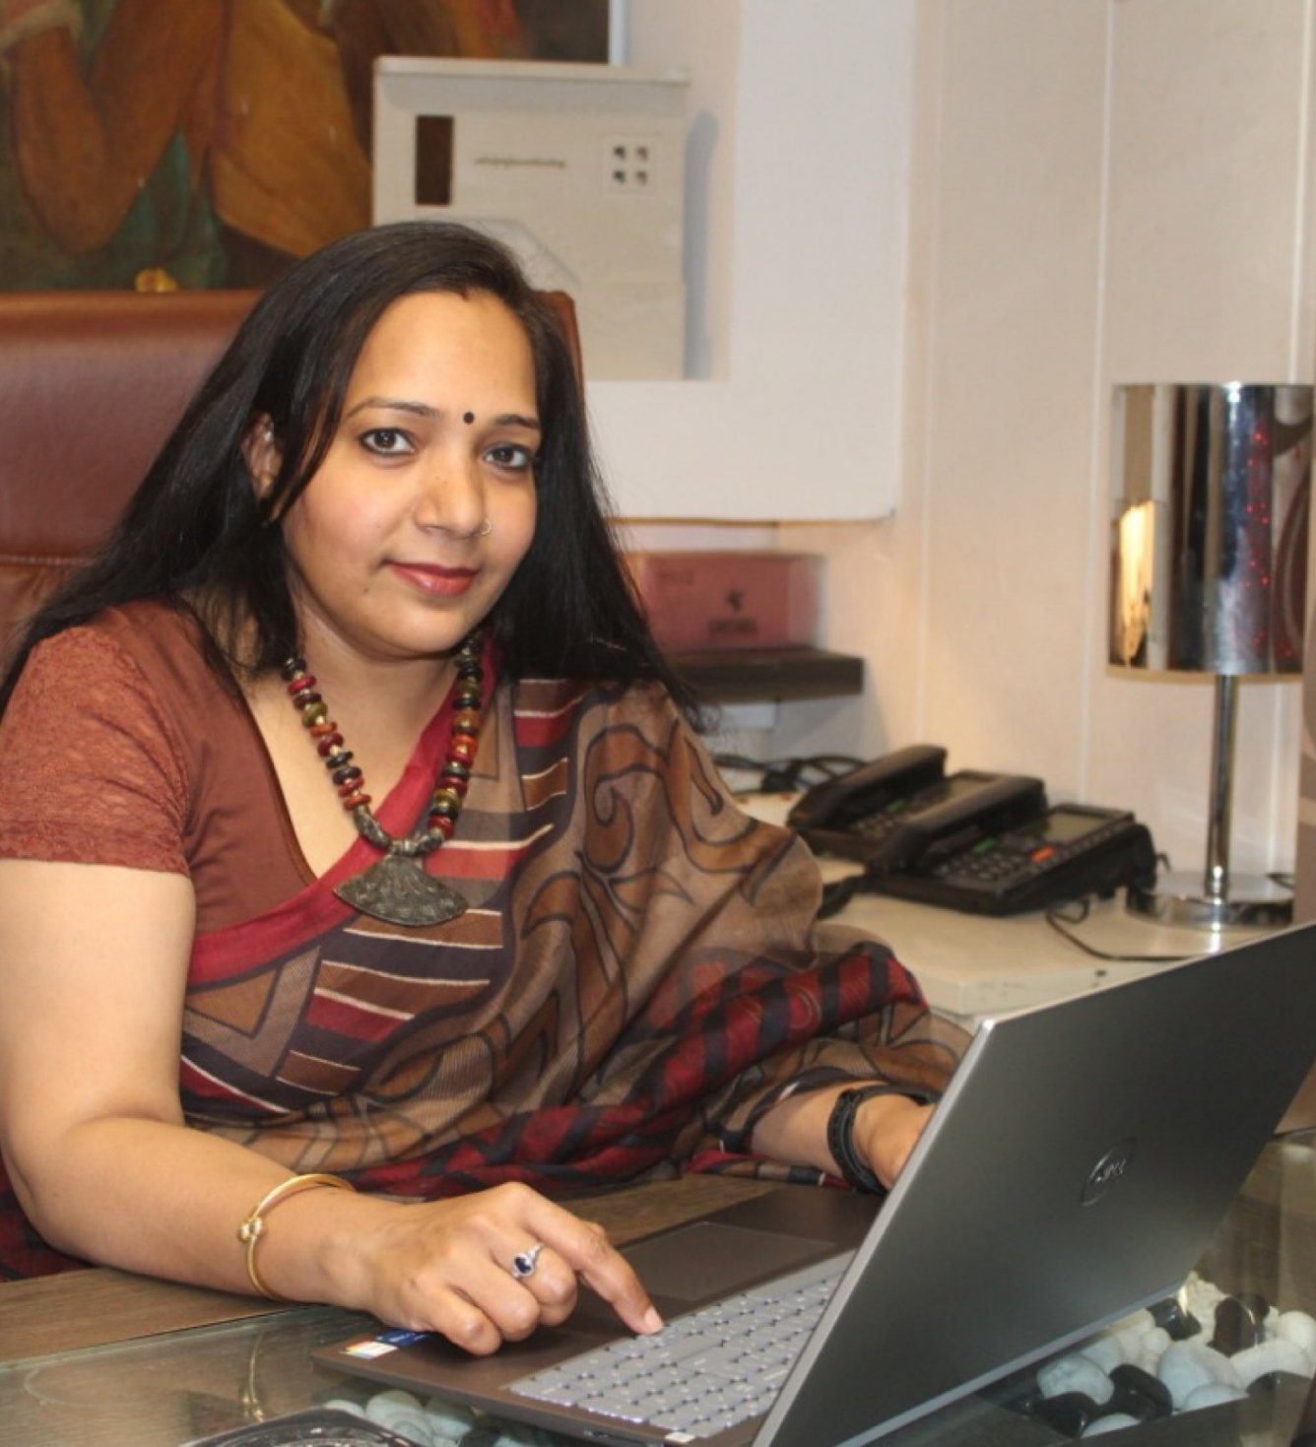
AR. BABITA SRIVASTAVA, COUNCIL MEMBER
CONSTRUCTION COUNCIL WICCI
Renowned and highly acclaimed, Ar. Babita Srivastava stands as an exemplary figure and a guiding light in the realms of interior design and architecture. With a rich tapestry of over 22 years in the industry, she has left an indelible mark through her contributions. Her expertise spans across diverse domains, including commercial, residential, and extensive large-scale projects across India.
Ar. Babita Srivastava's proficiency goes beyond the ordinary, rooted in a deep understanding of workplace strategies, vastu principles, and sustainable green building concepts. Her holistic approach plays a pivotal role in empowering clients to not just realize their aspirations, but to transcend them.
Babita is an associate member of IIA-Northern chapter(Delhi)

Slide 10
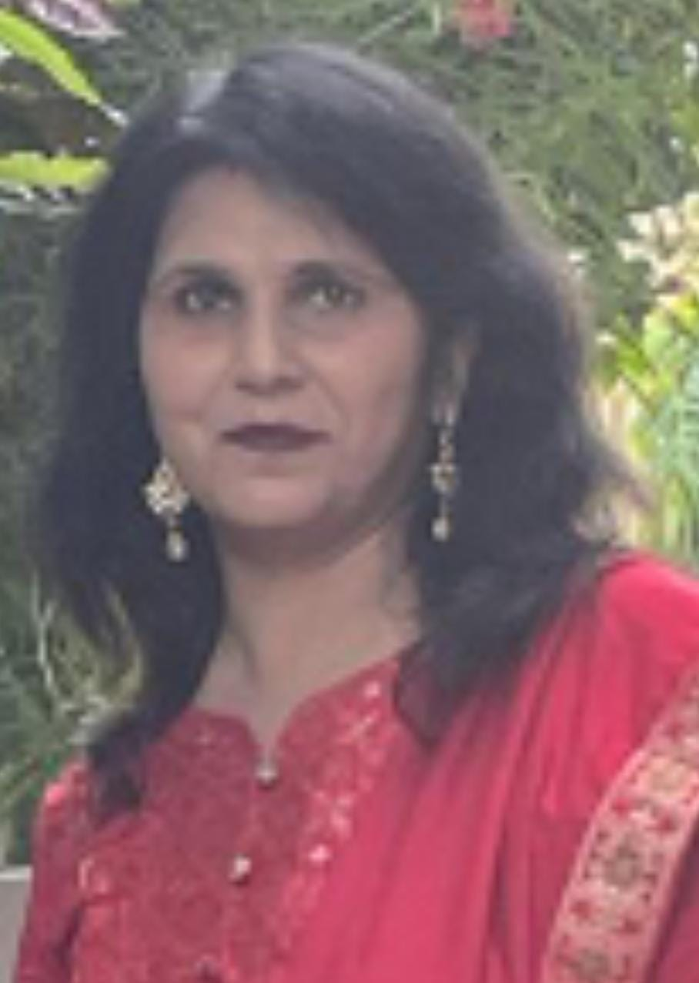
AR. SONIA BHUGRA, COUNCIL MEMBER
CONSTRUCTION COUNCIL WICCI
Sonia is an enthusiastic architect with 20 years of expertise overseeing a variety of projects including group housing, high-rise luxury residential houses, Institutional Buildings, Hospitals, and mixed-use commercial structures.
Sonia has a post-graduate degree in Urban Planning (M.Plan) after her B.Arch.
She is a member of various industry associations, including
Council of Architecture (COA) Delhi
Institute of Town Planner India (ITPI) Delhi

Slide 11
Ar. RASHMI PANDEY ,COUNCIL MEMBER CONSTRUCTION COUNCIL WICCI
With a creative and quality-focused Architect with 4 years experience in planning, designing, and construction documents including academics field . Her journey as an architect has been marked by a commitment to Communicates and collaborates with the client to understand functional and spatial requirements of new structure/site/renovation.
EDUCATION: B.ARCH from Mharishi Dayanand University and M.ARCH in LANDSCAPE from Mharishi Dayanand University .
Currently working as an Architect and Project coordinator in Vastukala Group, faridabad.

Slide 12
Ar. GULNAZ KHAN,COUNCIL MEMBER CONSTRUCTION COUNCIL WICCI
With a creative flair and a passion for design, Gulnaz has spent the past four years transforming architectural visions into breathtaking realities. Her journey as an architect has been marked by a commitment to innovation, attention to detail, and an unwavering dedication to creating spaces that seamlessly blend aesthetics with functionality.
EDUCATION: B.ARCH from Mharishi Dayanand University and M..ARCH from Jamia Millia Islamia, university.
Currently working as Assistant Professor in K.R Mangalam, University
She is a member of industry associations.
INTACH, Gurgaon Chapter

Slide 13
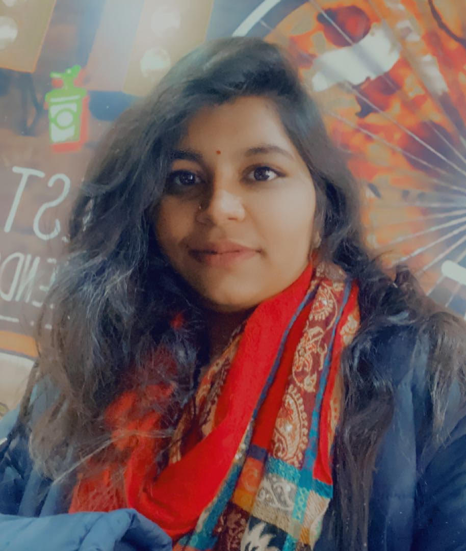
SIMRAN SHARMA, COUNCIL MEMBER, CONSTRUCTION COUNCIL, WICCI
She is self-motivated, creative and licensed architect with 5 years of experience in commercial, residential and institutional projects. She created designs that maximize efficiency and beauty.
She holds Master’s degree in Urban Regeneration from Jamia Millia Islamia University and have over five years of graduation in architecture and planning. Throughout her learnings, She had worked on various projects including land-use planning, transportation planning, and environmental assessments. These experiences have provided solid foundation in planning and executing successful urban development initiatives.
As an Urban Regeneration Specialist, her key strengths include ability to analyze complex data, develop innovative solutions in a professional manner. Her ability to multitask, prioritize and meet deadlines has ensured timely and successful completion of multiple projects in past roles.

Slide 14
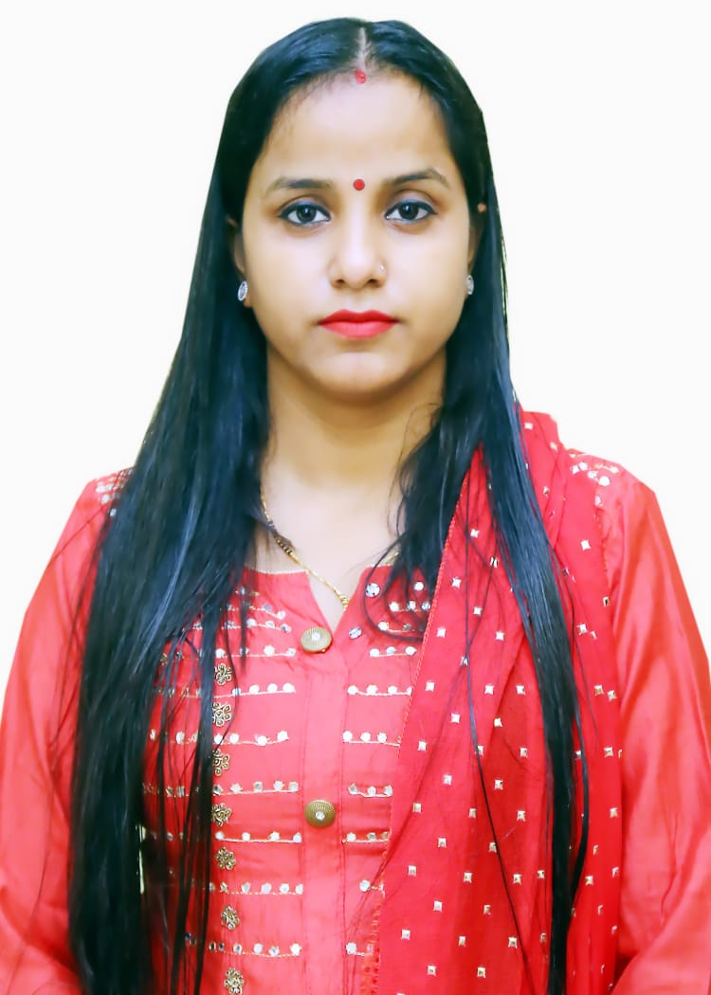
Ar. MEERA YADAV ,COUNCIL MEMBER CONSTRUCTION COUNCIL WICCI
Believe to professional transforms building designs into reality, ensuring functionality, safety, and creative vision with 5 years experience. Her journey as an architect has been marked by a Collaborating with engineers, they develop concepts for structures that meet project goals and operational standards, bringing architectural projects to life.
EDUCATION: B.ARCH from DCRUST University and M.ARCH in LANDSCAPE from Mharishi Dayanand University .
Currently working as an Architect in KROMA DIGITAL SEVICES Group.
Insert High Resolution Picture

Slide 15
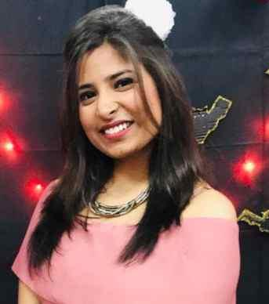
PALLAVI,COUNCIL MEMBER CONSTRUCTION COUNCIL WICCI
Meet Architect Pallavi, a seasoned professional with a robust educational background, holding a BSc in Interior Design, a B.Arch, and an M.Arch with a Landscape specialization. Her diverse experience spans Residential, Commercial, Industrial, and Institutional projects, showcasing her adaptability and commitment to architectural excellence.
Pallavi's skill set is extensive, covering Planning, Interior design, Elevation, Vastu integration, Landscape architecture, and 3D visualization. Her projects seamlessly blend aesthetics and functionality, reflecting her creative vision and technical acumen.
She is anchored in punctuality, responsibility, and an unwavering dedication to exploring new design horizons. Her thirst for innovation sets her apart, ensuring that her work remains fresh, on-trend, and at the forefront of the industry.
Her career is defined by a passion for crafting spaces that inspire, underscored by a foundation of education, a breadth of experience, and a constant drive to evolve. Her designs resonate with professionalism and creativity, elevating environments with a touch of brilliance.

Slide 16
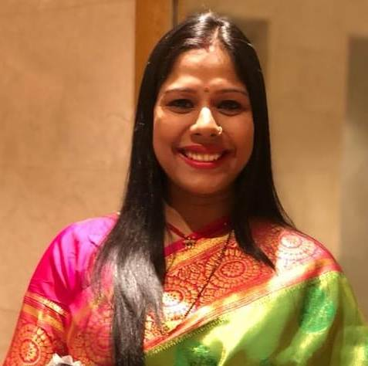
PALLAVI,COUNCIL MEMBER CONSTRUCTION COUNCIL WICCI
Suruchi is self-motivated, creative and licensed architect with 8 years of experience in commercial and residential projects. She created designs that maximize efficiency and beauty. She is able to create a faster, modern and responsive layout and design experience keeping real users in mind.
Planning is her favorite word, either personal or professional life planning is more important. Whenever we move a head by planning in our life it becomes easy to live and success is sure to come. Specially in my profession architecture planning is first step of any construction project.
EDUCATION:-
Bachelor of architecture from Maharshi Dayanand University
University in Rohtak, Haryana
WORK EXPERICENCE:
Currently working as an senior Architect and Project head in Vastukala Group, Faridabad.
She is a member of IIA Haryana

Slide 17
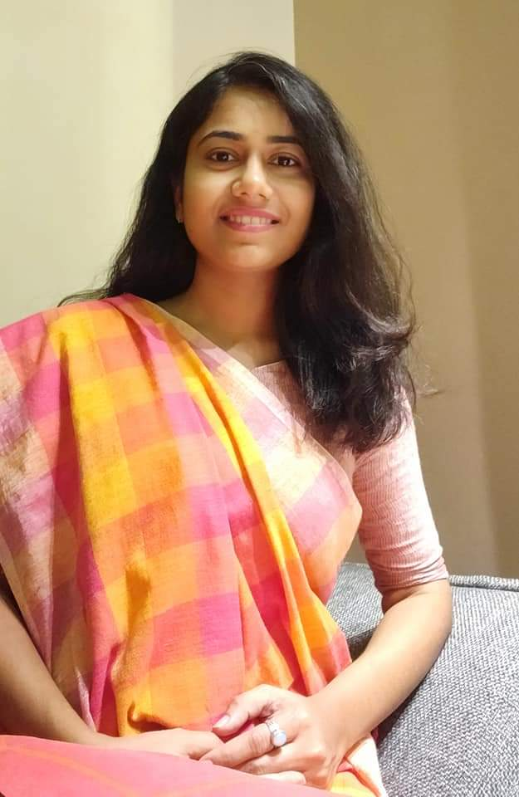
DHANSHRI,COUNCIL MEMBER CONSTRUCTION COUNCIL WICCI
Versatile architect accomplished at designing commercial and residential structures of varying styles and perfectly customized plans for client’s unique technical and budgetary needs.
Proficient at creating ideal frameworks and structures that exceeds customer’s expectation while adhering to prescribed budgetary concerns.

Slide 18
TYPE NAME & WICCI DESIGNATION
COUNCIL MEMBER, (…………. )COUNCIL WICCI
BIO :-
Type Text
Insert High Resolution Picture

Slide 19
TYPE NAME & WICCI DESIGNATION
COUNCIL MEMBER, (…………. )COUNCIL WICCI
BIO :-
Type Text
Insert High Resolution Picture

Slide 20
TYPE NAME & WICCI DESIGNATION
COUNCIL MEMBER, (…………. )COUNCIL WICCI
BIO :-
Type Text
Insert High Resolution Picture

Slide 21
TYPE NAME & WICCI DESIGNATION
COUNCIL MEMBER, (…………. )COUNCIL WICCI
BIO :-
Type Text
Insert High Resolution Picture

Slide 22
TYPE NAME & WICCI DESIGNATION
COUNCIL MEMBER, (…………. )COUNCIL WICCI
BIO :-
Type Text
Insert High Resolution Picture

Slide 23
TYPE NAME & WICCI DESIGNATION
COUNCIL MEMBER, (…………. )COUNCIL WICCI
BIO :-
Type Text
Insert High Resolution Picture

Slide 24
TYPE NAME & WICCI DESIGNATION
COUNCIL MEMBER, (…………. )COUNCIL WICCI
BIO :-
Type Text
Insert High Resolution Picture

Slide 25
TYPE NAME & WICCI DESIGNATION
COUNCIL MEMBER, (…………. )COUNCIL WICCI
BIO :-
Type Text
Insert High Resolution Picture

Slide 26
TYPE NAME & WICCI DESIGNATION
COUNCIL MEMBER, (…………. )COUNCIL WICCI
BIO :-
Type Text
Insert High Resolution Picture

Slide 27
TYPE NAME & WICCI DESIGNATION
COUNCIL MEMBER, (…………. )COUNCIL WICCI
BIO :-
Type Text
Insert High Resolution Picture

Slide 28
TYPE NAME & WICCI DESIGNATION
COUNCIL MEMBER, (…………. )COUNCIL WICCI
BIO :-
Type Text
Insert High Resolution Picture

Slide 29
TYPE NAME & WICCI DESIGNATION
COUNCIL MEMBER, (…………. )COUNCIL WICCI
BIO :-
Type Text
Insert High Resolution Picture

Slide 30
TYPE NAME & WICCI DESIGNATION
COUNCIL MEMBER, (…………. )COUNCIL WICCI
BIO :-
Type Text
Insert High Resolution Picture

Slide 31
TYPE NAME & WICCI DESIGNATION
COUNCIL MEMBER, (…………. )COUNCIL WICCI
BIO :-
Type Text
Insert High Resolution Picture

Slide 32
SUPPORTED BY
WICCI is supported by the massive global networks of ALL Ladies League (ALL), Women Economic Forum (WEF), and SHEconomy.
ALL is a movement of ‘Sisters Beyond Borders.’
WEF is a platform for ‘Business Beyond Borders.’ SHEconomy is e-commerce for women worldwide in Goods & Services for ‘Commerce Beyond Borders’

Slide 33
COUNTRIES REPRESENTED
Albania, Angola, Armenia, Argentina, Australia, Azerbaijan, Bangladesh, Brazil, Burundi, Cameroon, Canada, Chad, China, Costa Rica, Croatia, Cyprus, Czech Republic, Colombia, Ecuador, Egypt, Ghana, Germany, Greece, Guatemala, Hong Kong, Hungary, India, Italy, Israel, Ireland, Japan, Kazakhstan, Kenya, Kyrgyzstan, Lesotho, Luxembourg, Malawi, Malaysia, Mexico, Moldova, Monaco, Montenegro, Morocco, Mozambique, Malta, Netherlands, Nigeria, Nepal, New Zealand, North Macedonia, Norway, Paraguay, Portugal, Peru, Puerto Rico, Philippines, Qatar, Romania, Russia, Rwanda, Serbia, Singapore, Slovenia, Spain, South Africa, South Korea, Suriname, Sweden, Switzerland, Syria, Tunisia, Turkey, Uganda, Ukraine, UK, Uruguay, Venezuela, Vietnam, Virgin Islands (US), UAE, USA, Uzbekistan, Zimbabwe.

Slide 34
WOMEN'S INDIAN CHAMBER OF COMMERCE ANDINDUSTRY

